Slide 1

IGVC: Recap and Status
IGVC
AutoMav
Dario Ugalde, Awet Tesfamariam, Andrew Break, Amgad Alamin, Warren Smith

Slide 2
Initial Project Goals
GPS Navigation
Wireless Control
Obstacle Detection
Lane Detection
Pathfinding

Slide 3
Final Project Goals
Chassis Redesign
Rewiring
System Configuration
Motor Controller Configuration
Manual Control
Global Mapping
Gimbal Mount Configuration
GPS Navigation
Wireless Control
Lane Detection
Pathfinding
Documentation and User Manual

Slide 4
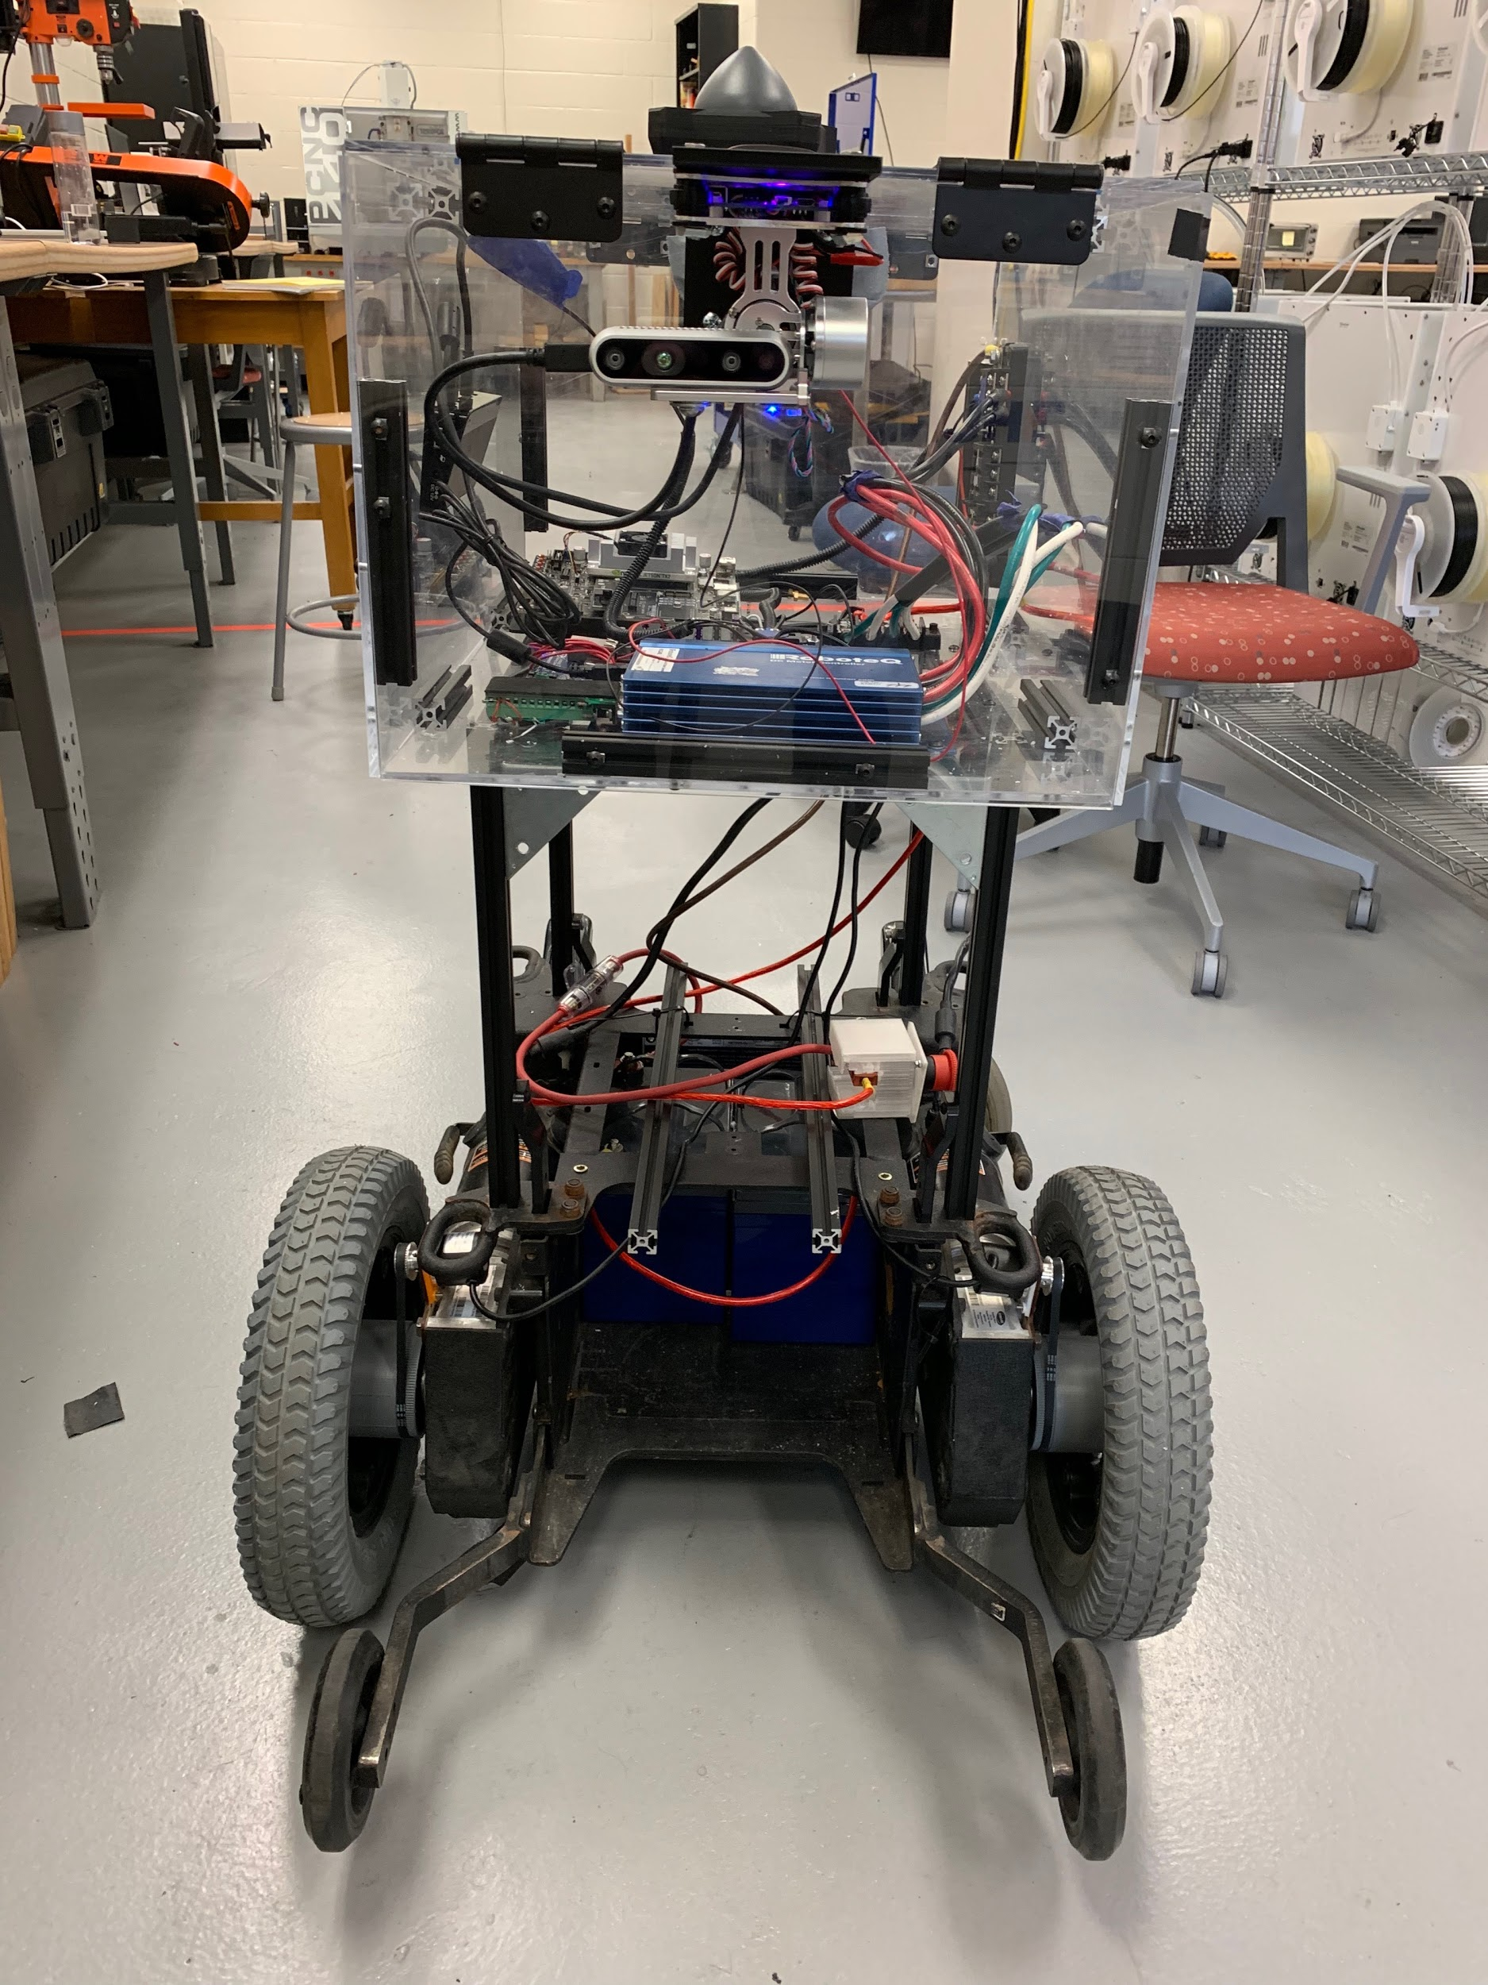
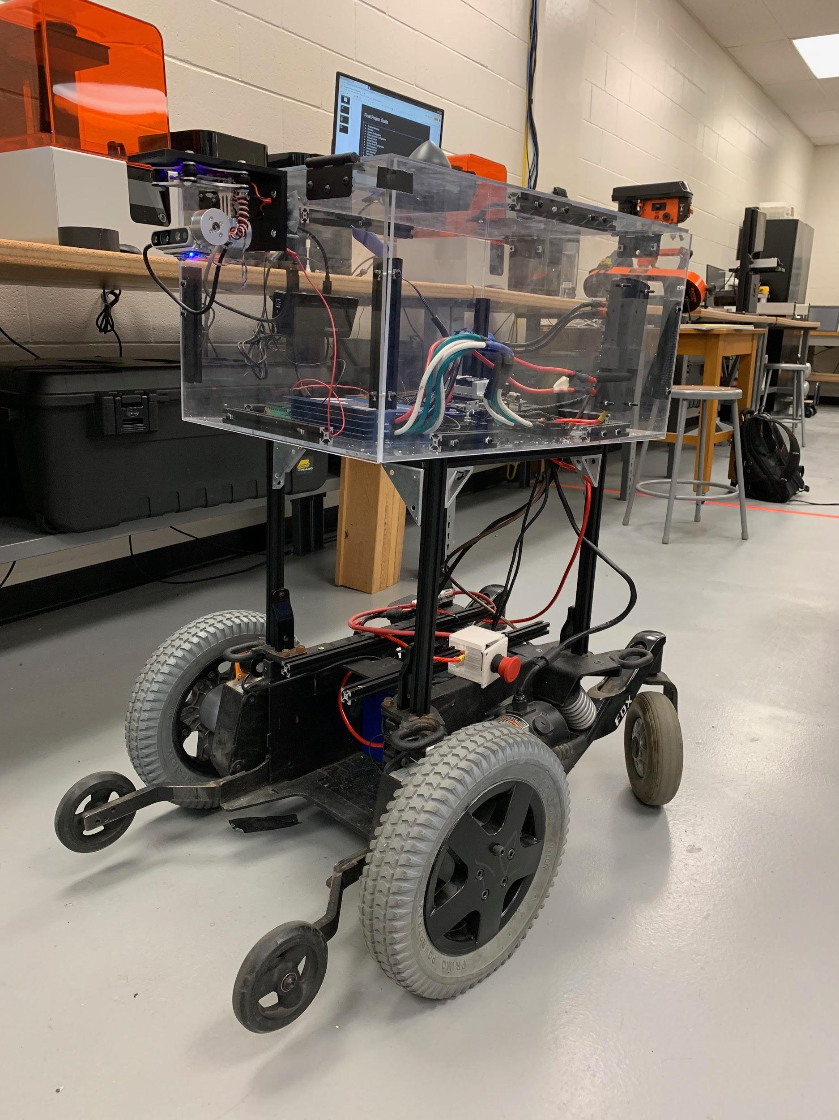
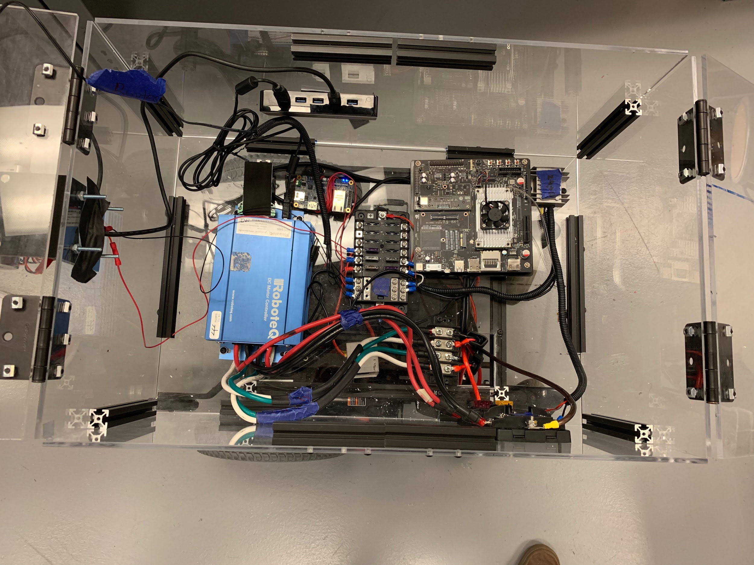
Friday Demo
Non-Autonomous Movement
Global Mapping
Simulated Pathfinding

